Slide 1


Short Throw Backdrop
ECE 4805 S23-22
Critical Design Review
Fatima Alkaabi, Frank Shay, Jackson Pittman, Greg Brinson, Mariam Singer

Slide 2
Overview
Design Concept
Requirements Specification
Architecture Design Concept
Project Subsystems Designs
Backdrop
Lens
Motor
Interface
Mounting
Schedule
Budget
End Product

Slide 3
Design Concept
INPUTS:
Motorized Backdrop
Projectors With Lens
Controlling Interface
OUTPUTS:
HDMI
Image on Screen
VGA
Wireless
Inputs
Backdrop
Motor
Backdrop Mounting
Projectors
Lens
Projector & Lens Mounting
Remote Controller
Tablet
Device Mounting

Slide 4
Requirements Specification
Metric | Priority | Units | Marginal Value | Ideal or Target Value
Throw distance | 5 | Feet | ~12’-13’ | 12.5’
Projection Size | 4 | Centimeters | 800-950 X 300-400 | 915 X 400
Projection Quality | 3 | Pixels | 720p to 4k | 1080p
Backdrop Size | 2 | Feet | 30’ by 14’ | 18’ by 14’
Projector lumens | 1 | Lumens | 4000 to 5000 Lumens | 5000 Lumens
Note: 1 is the highest priority

Slide 5
Architecture Design Concept
Backdrop
Projectors
Lens
Motor
Remote Controller
Connectors
Display
Controllers
Mounting
Wiring
Micro- Controller
(hardware/software)

Slide 6
Project Subsystems
Backdrop: Greg
Lens: Jackson
Motor: Mariam
Interface: Fatima
Mounting: Frank

Slide 7
Backdrop
Lowest Deliverable: | Gain 1.0 and Half Angle 30º
Desired Deliverable: | Gain 1.1 to 1.2 Half Angle 30º
Highest Deliverable: | Gain 1.3 and Above and Half Angle 30º
Show things like : schematic, wiring diagrams, object entity diagrams, complete algorithms, etc.)
Test Plan
List Final desired Deliverable
List one innovative aspect about your choice / one advantage this choice that the team has picked provides
List future steps for next semester regarding this subsystem

Slide 8
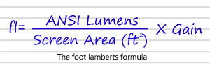
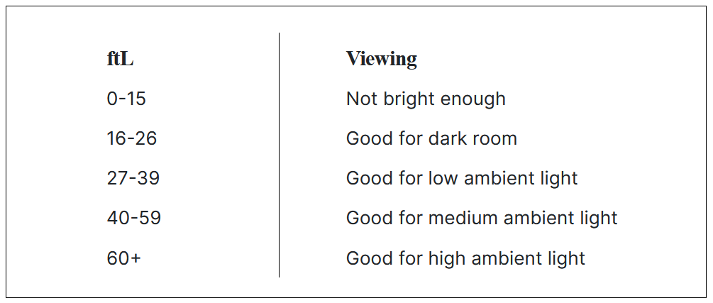
Backdrop Specification
18’ by 14’ in size
Stored on tube inside cage to be hung
Backdrop Gain Adequate
FL = Projector Lumens / Screen Area (ft²) * Backdrop Gain = 45
Good for medium ambient light

Slide 9
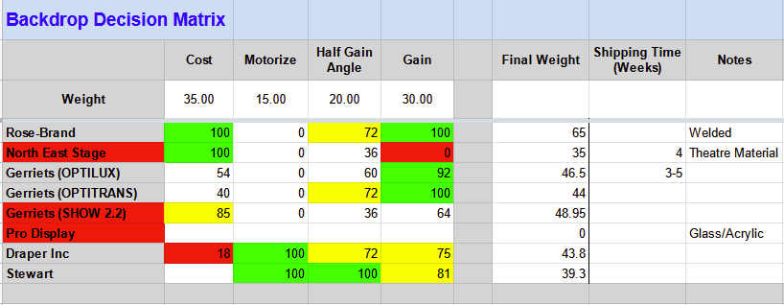
Backdrop

Slide 10
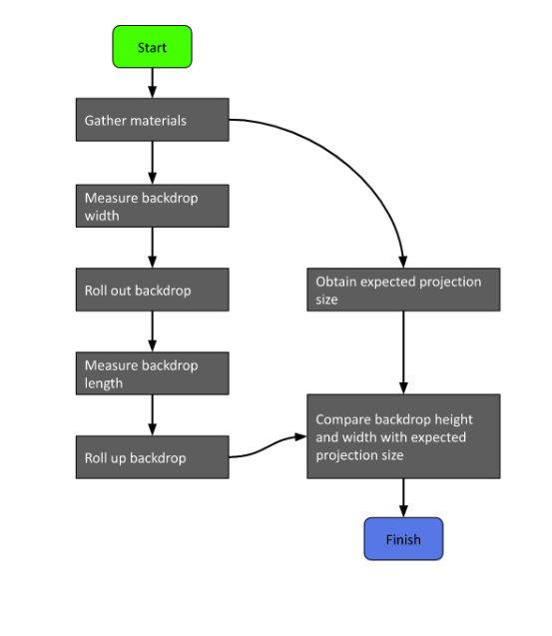
Test Plan
Test for proper size
Height
Width
Safety
Clear space around backdrop
Heavy screen

Slide 11
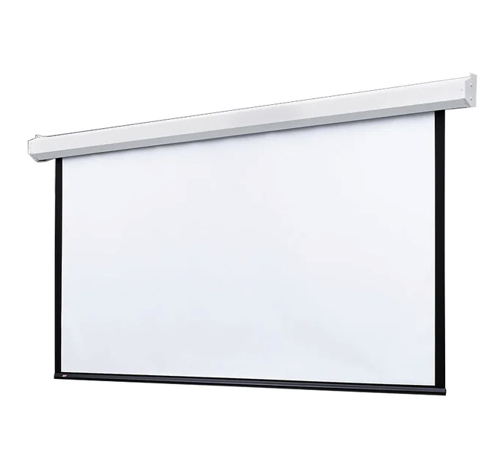
Final Expectations
Mount system 14’ above floor
Wrap backdrop on metal tube
Encase tube in cage for storage
Attach motors and drivers
Hang from ceiling in auditorium

Slide 12
2. Lens
Lowest Deliverable: | Lenses are fixed focus and in assembly.
Desired Deliverable: | Lenses are mounted custom to projector (non-adjustable) with variable focus lens.
Highest Deliverable: | Lenses are mounted with a custom and adjustable. The lenses are also variable focus.

Slide 13
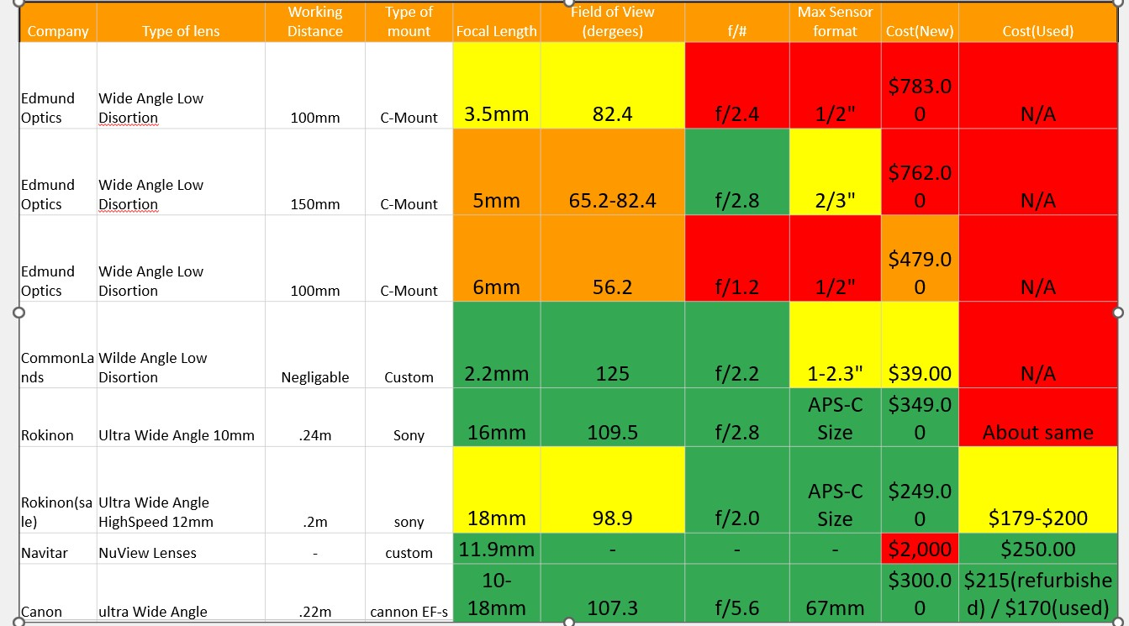
Lens Decision Matrix

Slide 14
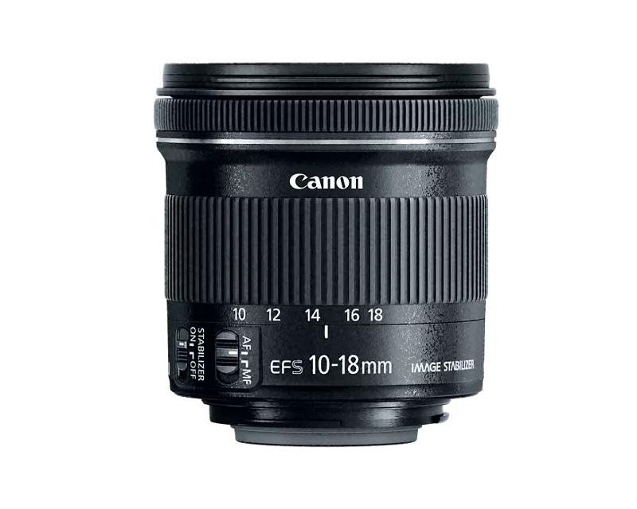
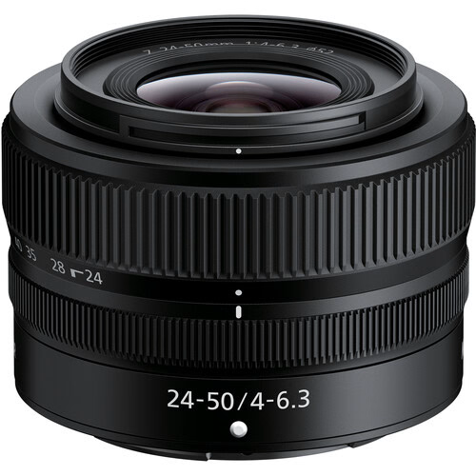
Nikon NIKKOR Z 24-50mm f/4-6.3 Lens (Refurbished by Nikon USA)
Refurbished EF-S 10-18mm f/4.5-5.6 IS STM

Slide 15
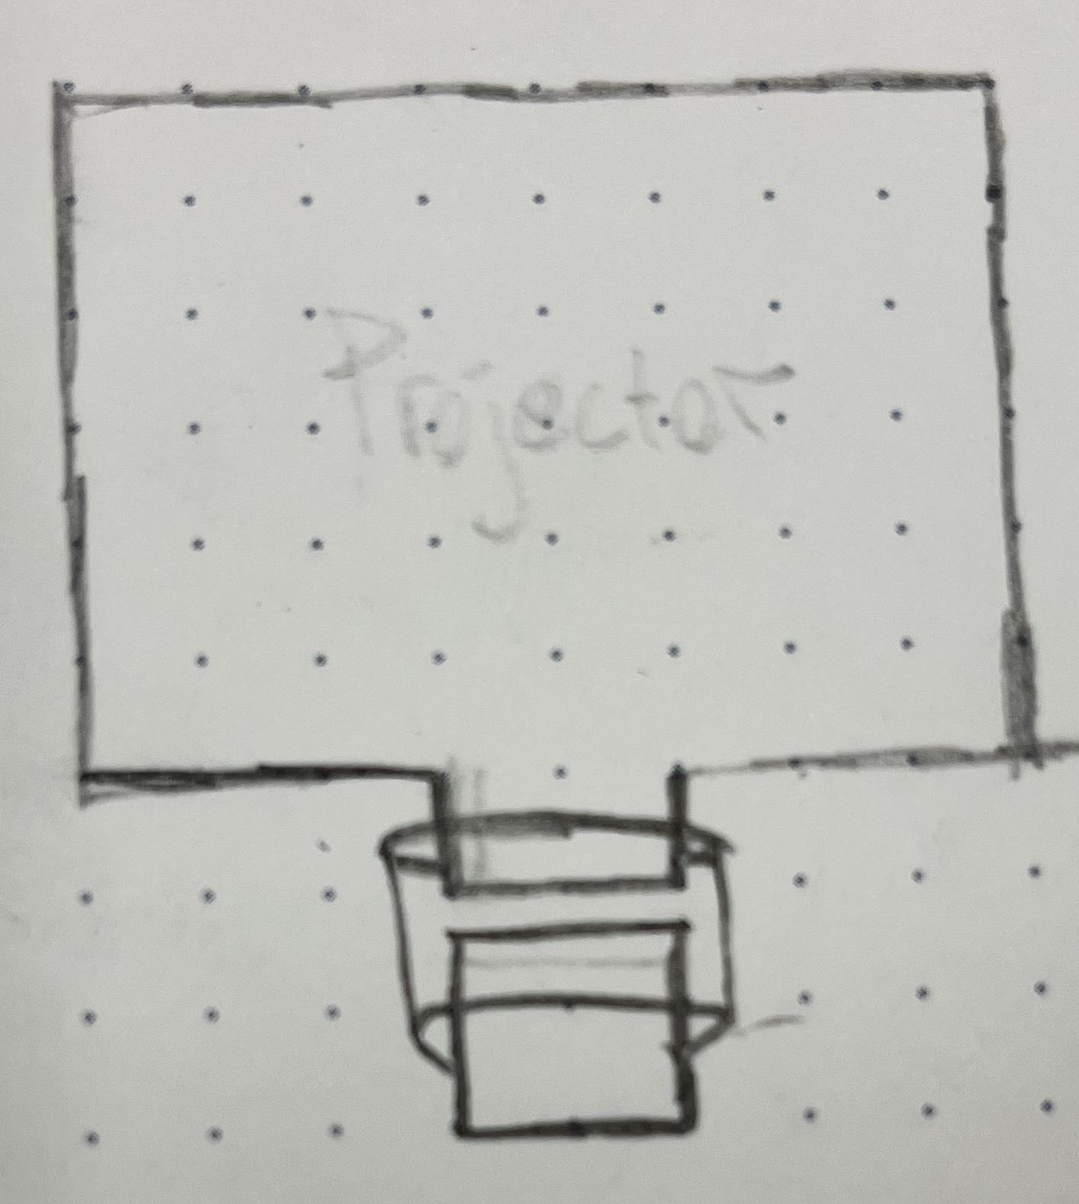
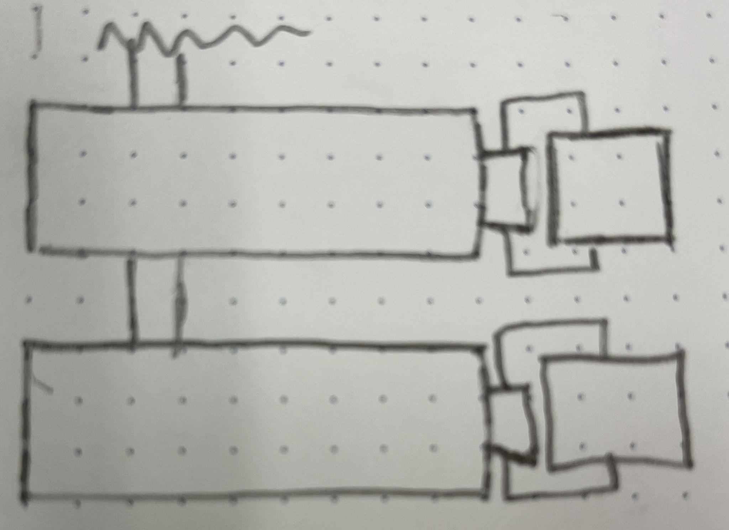
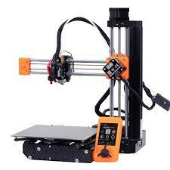
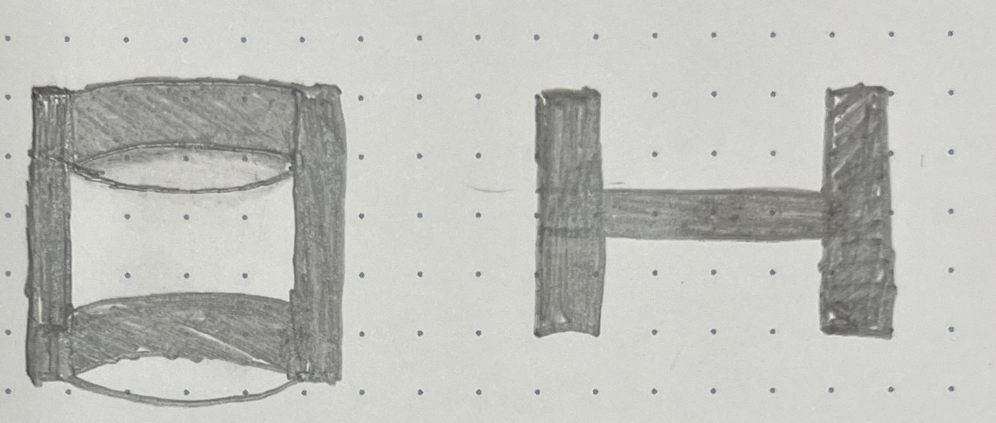

Projector
Projector
Projector
Attachment Assembly:
Attachment will be custom fabricated
It will firmly attach the lens to the projector
It will be minimal

Slide 16
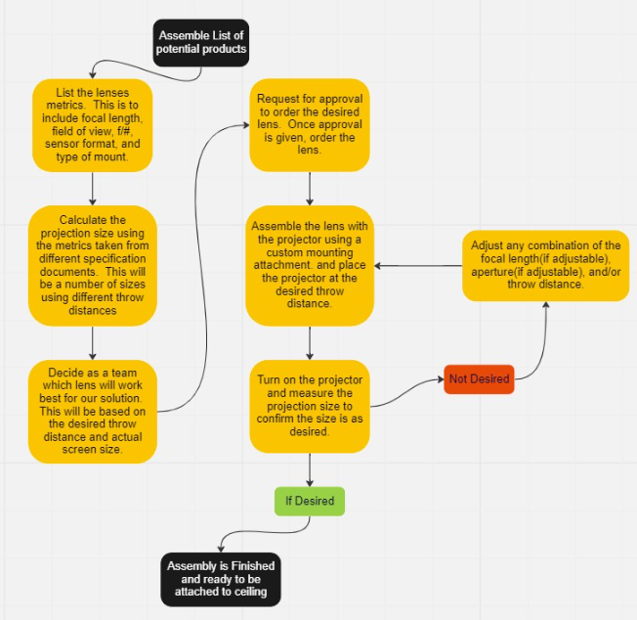
Verification Test Plan
The goal of this test is to verify the optical attachment
and throw distance yield the desired projection size.

Slide 17
Lens Conclusions
The team recently changed the focal length to about 151 inches. This changes the field of view requirement.
Lenses can be found as low as $150, but they are significantly lower quality than lenses in the $300 range.
A Variable focus lens is desirable
Team’s Recommendation: A Camera Lens that will accommodate for 85 degree field of view (diagonal).

Slide 18
Future Steps:
Acquire lenses
Design and model the attachment for projector to lens
Start to complete test cases
Take feedback and improve on attachment
Conduct final tests in the middle school

Slide 19
3. Motor
Lowest Deliverable: | Motor rolls backdrop screen up and down safely
Desired Deliverable: | Motor rolls backdrop screen up and down safely, consistently, and evenly
Highest Deliverable: | Motor rolls backdrop screen up and down safely, consistently, evenly, and with a user controlled speed
Notes:
Show things like : schematic, wiring diagrams, object entity diagrams, complete algorithms, etc.)
Test Plan
List Final desired Deliverable
List one innovative aspect about your choice / one advantage this choice that the team has picked provides
List future steps for next semester regarding this subsystem

Slide 20
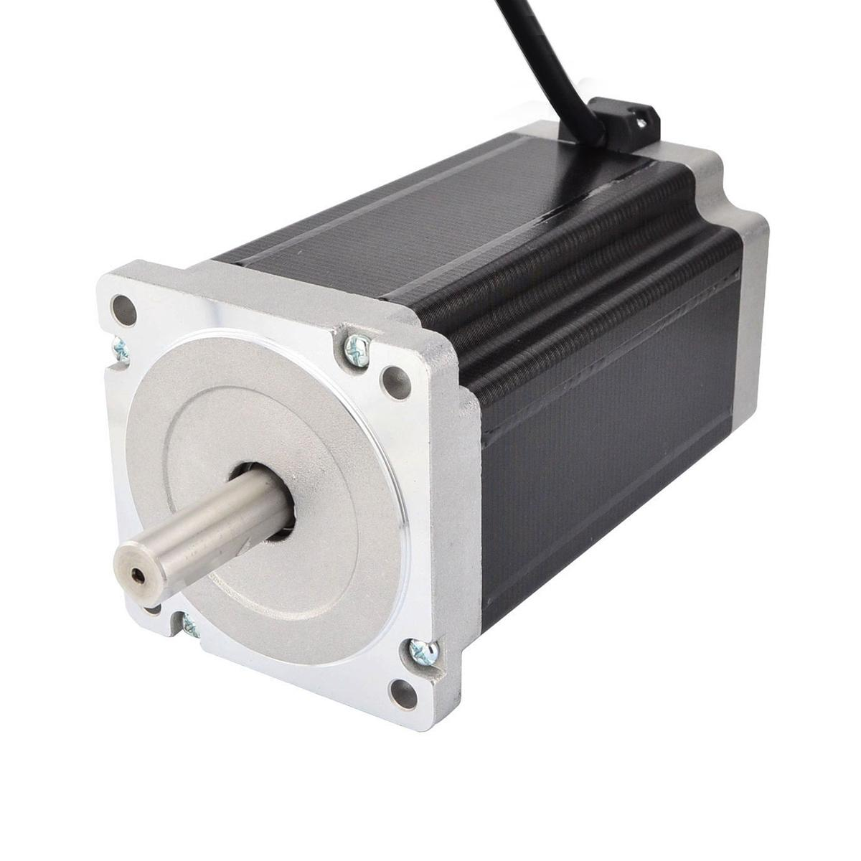
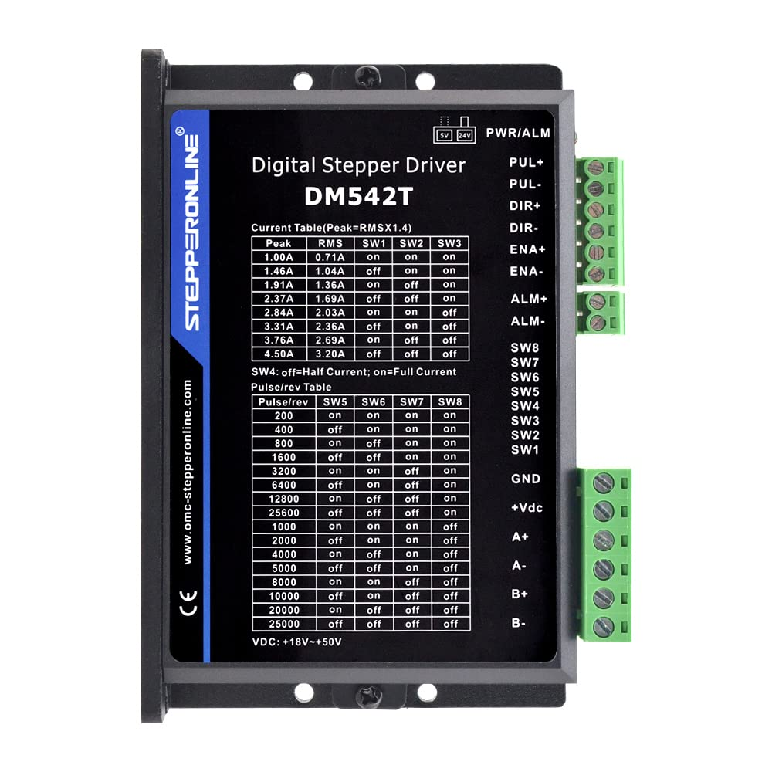
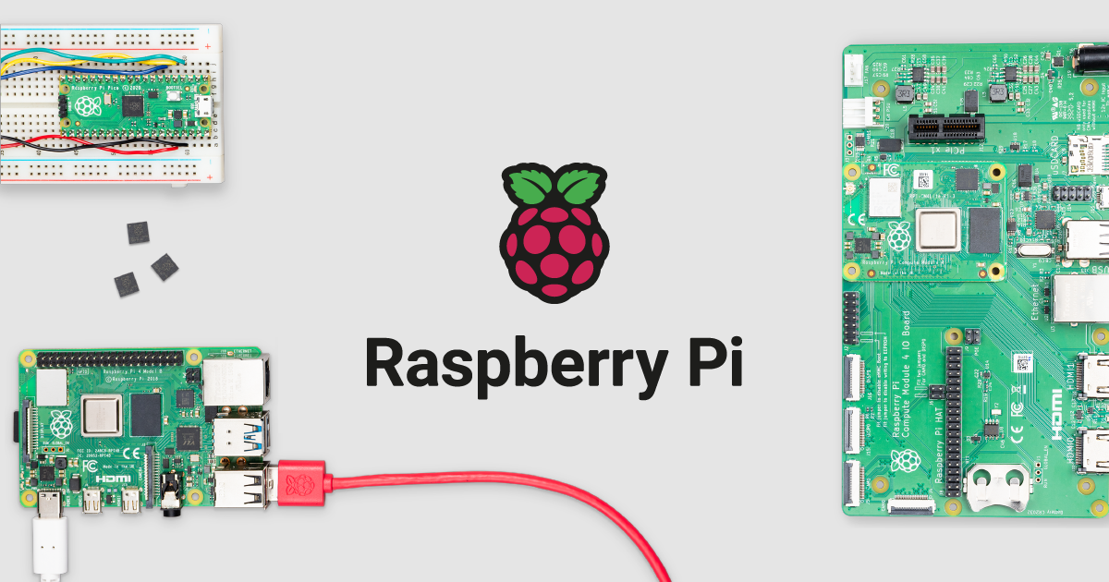
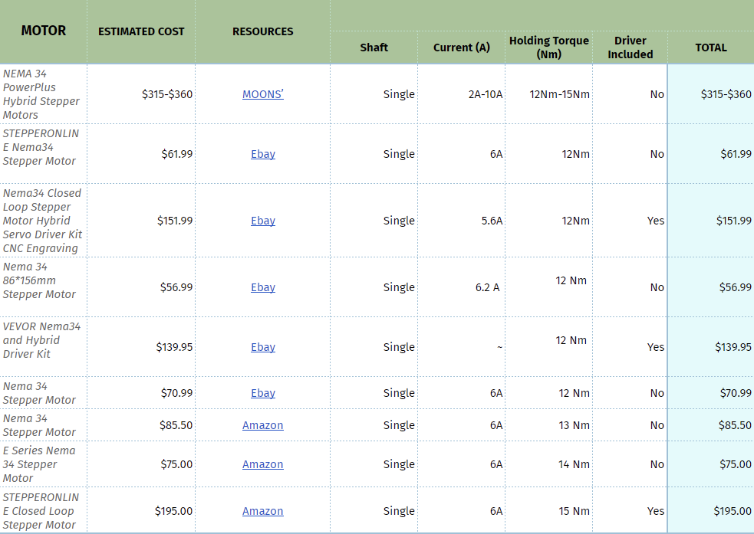
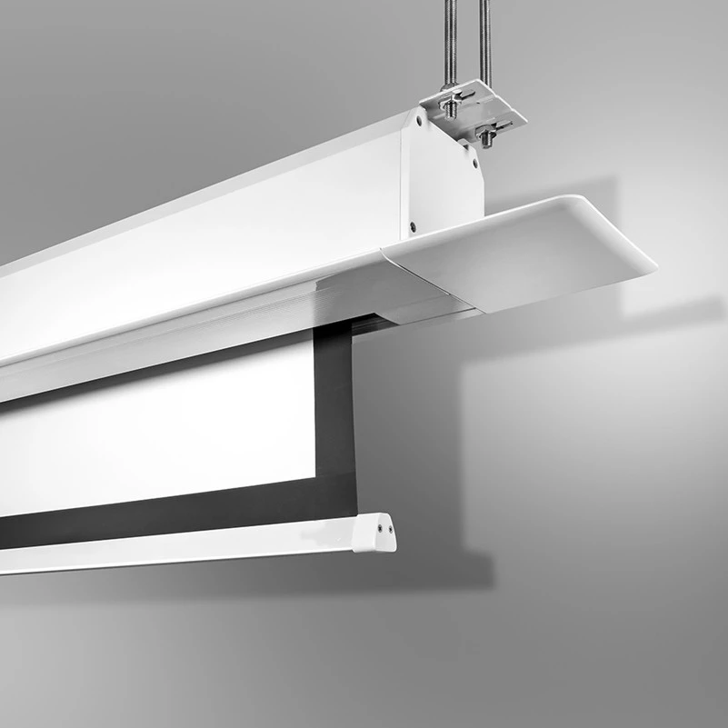
Motor Research
Stepper Motor
NEMA 34, 12 NM, 6A
Driver & Microcontroller
Smooth Functionality
3D Printing
Screen case
Motor case
Cost

Slide 21
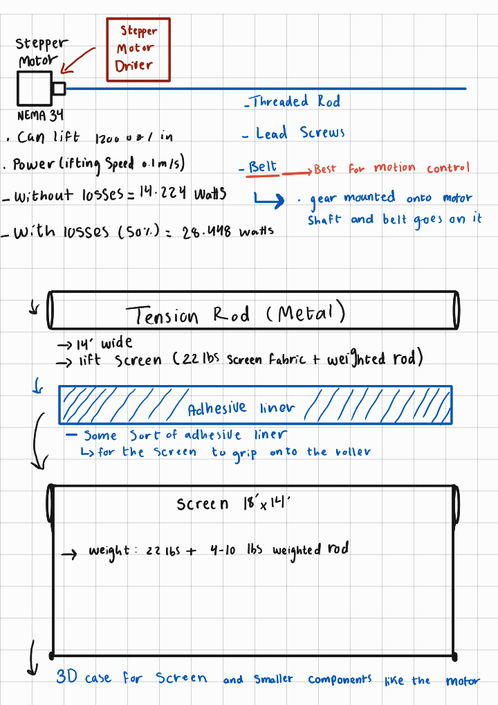
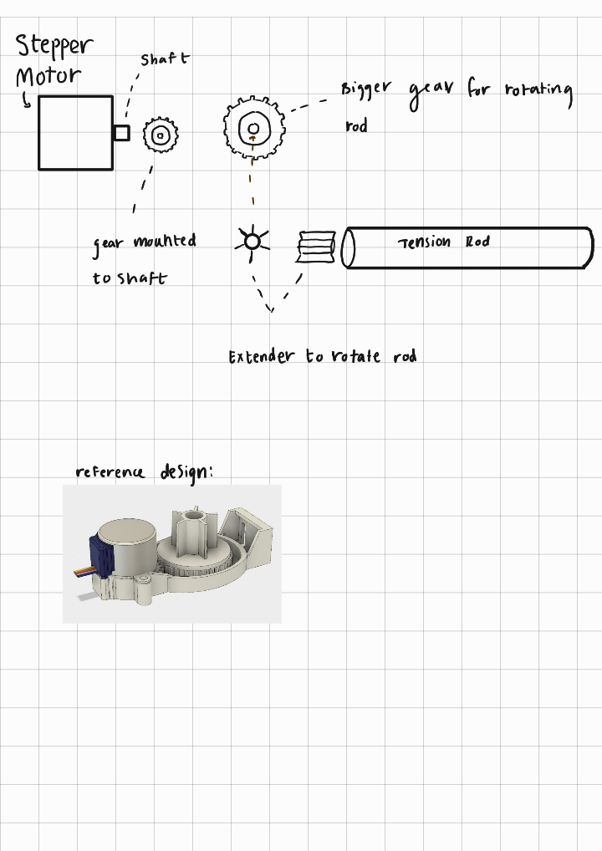

Slide 22
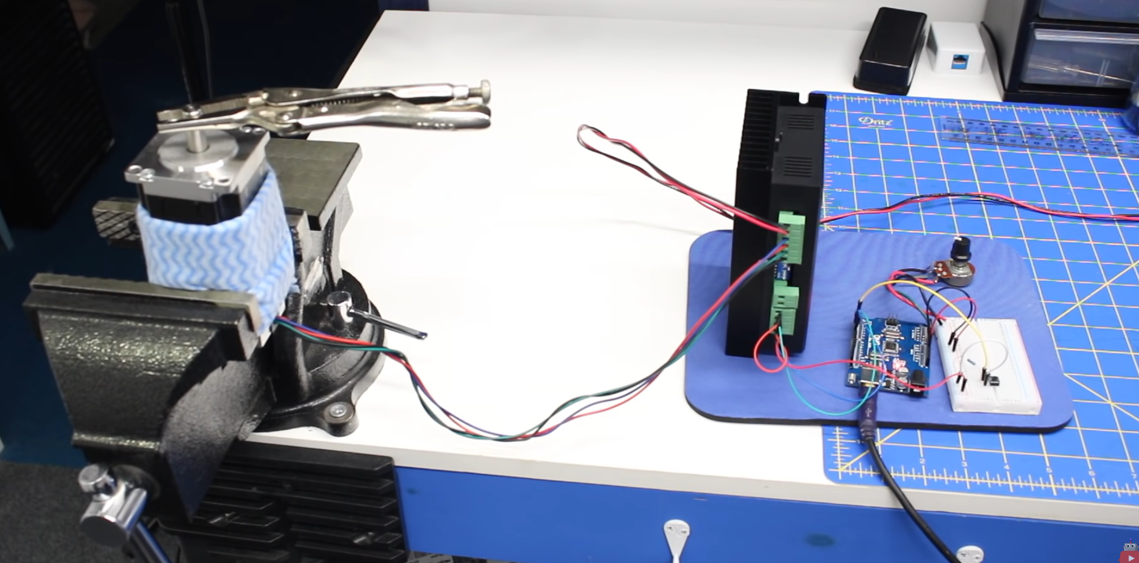
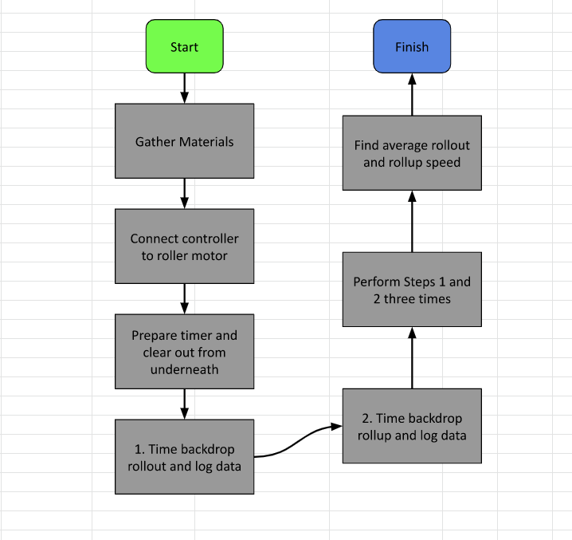
Test Plan
The motor will first be tested individually with driver and Raspberry Pi
The motor will be tested with a simple roll up screen or shade prior to testing it with the backdrop screen
The motor will be assembled with the backdrop screen and tested for speed and efficiency
Notes:
-https://youtu.be/iY_4YOlpqyI

Slide 23
Future Steps
Acquire Stepper Motor
Acquire Stepper Motor Driver
Drive and Control motor with stepper motor driver and Raspberry Pi
Test Motor
Come up with a detailed assembly plan
Acquire additional material for assembly
Conduct final tests
Notes:
Motor -> Geared Chain Drive -> Tension Rod -> Screen Fabric -> Case
Reach out to the VT Mechanical Engineering department
Belt, chain drive, metal rod, 3D printed case

Slide 24
4. Interface
Lowest Deliverable: | Remote Controller for Projector & Backdrop Motor.
Desired Deliverable: | Remote Controller and Tablet to control Projector & Backdrop Motor (Stationary).
Highest Deliverable: | Remote Controller and Tablet to control Projector and Backdrop Motor with additional creative features including backdrop animation (mobile) .
Notes:
Show things like : schematic, wiring diagrams, object entity diagrams, complete algorithms, etc.)
Test Plan
List Final desired Deliverable
List one innovative aspect about your choice / one advantage this choice that the team has picked provides
List future steps for next semester regarding this subsystem

Slide 25
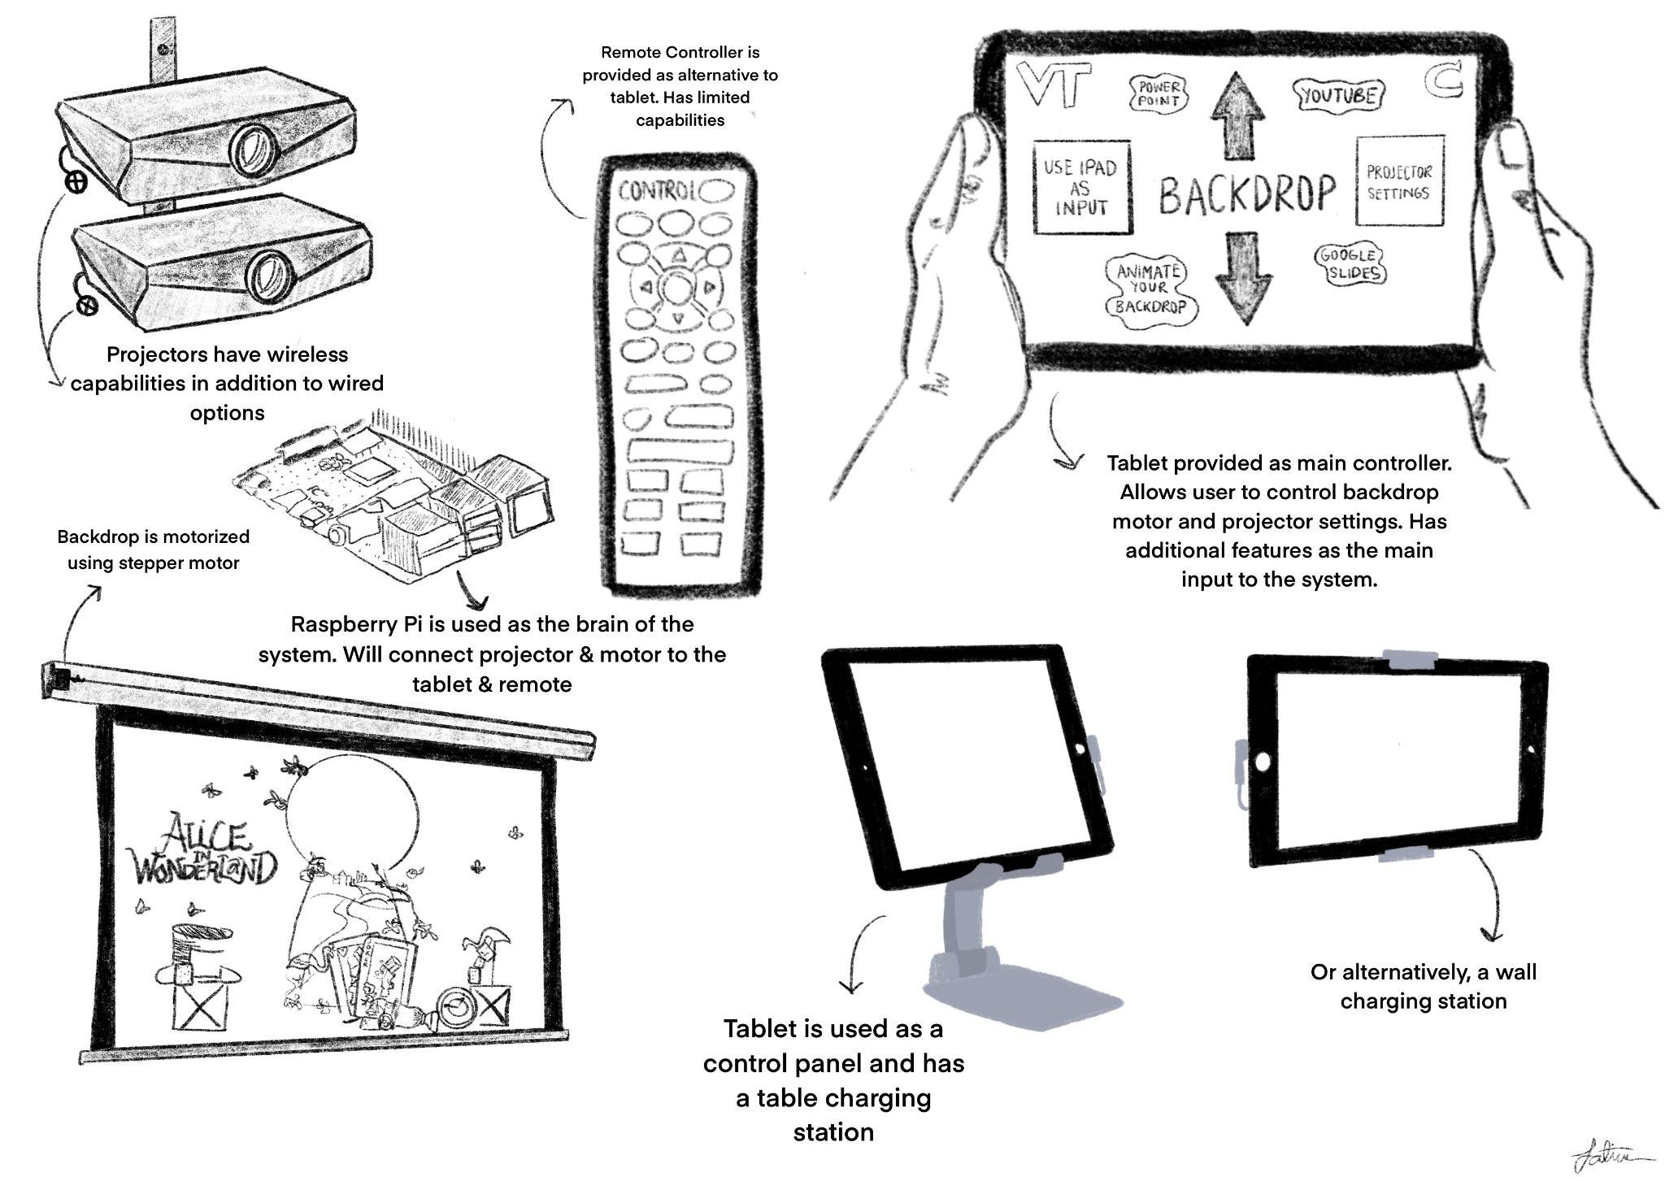

Slide 26
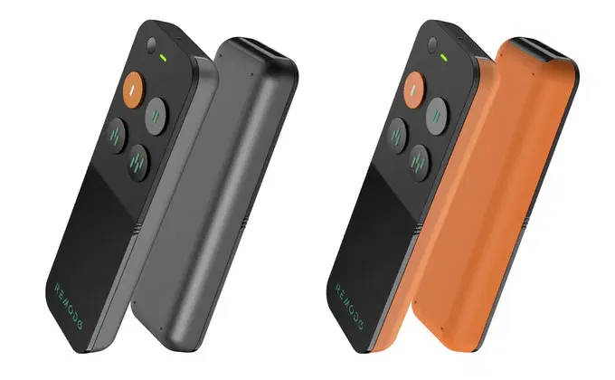
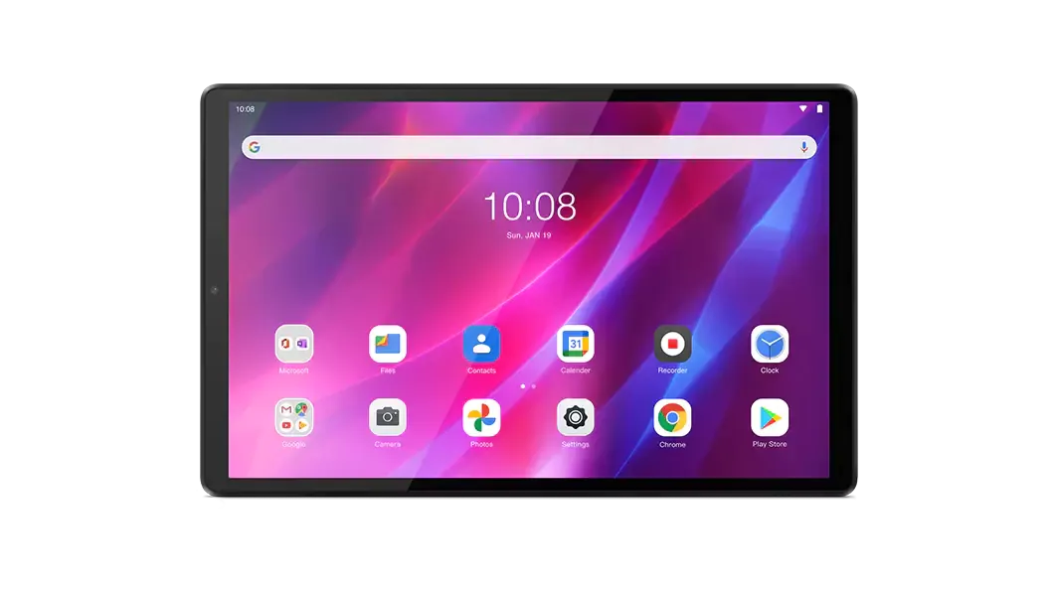
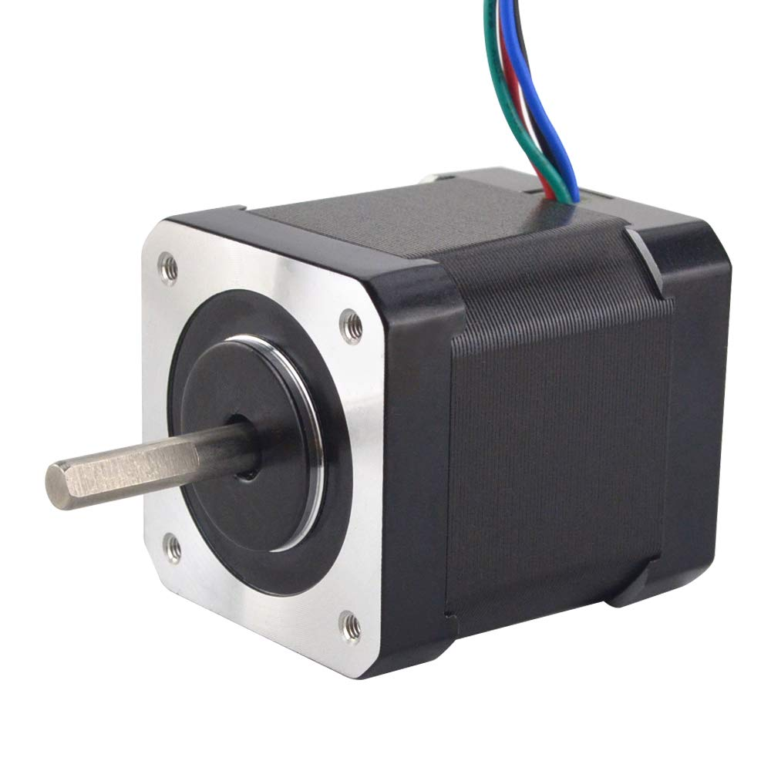
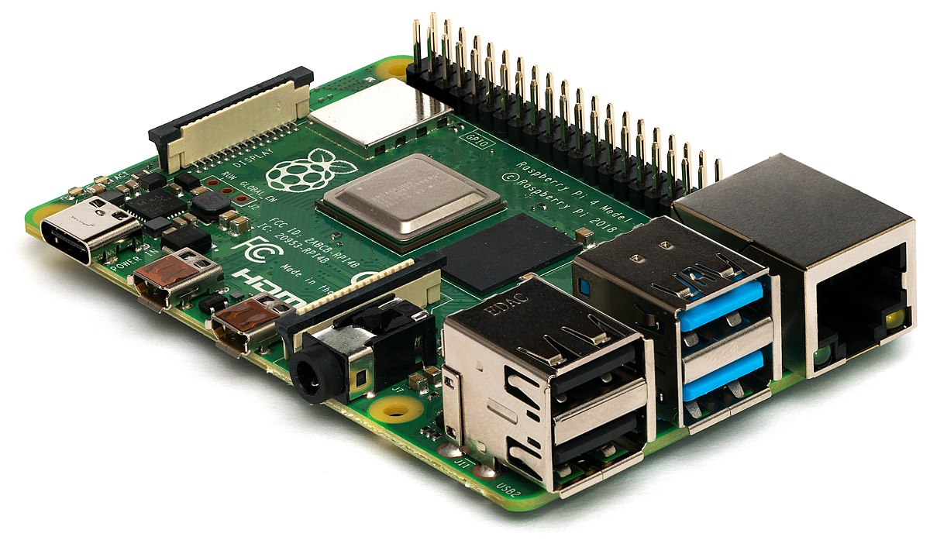
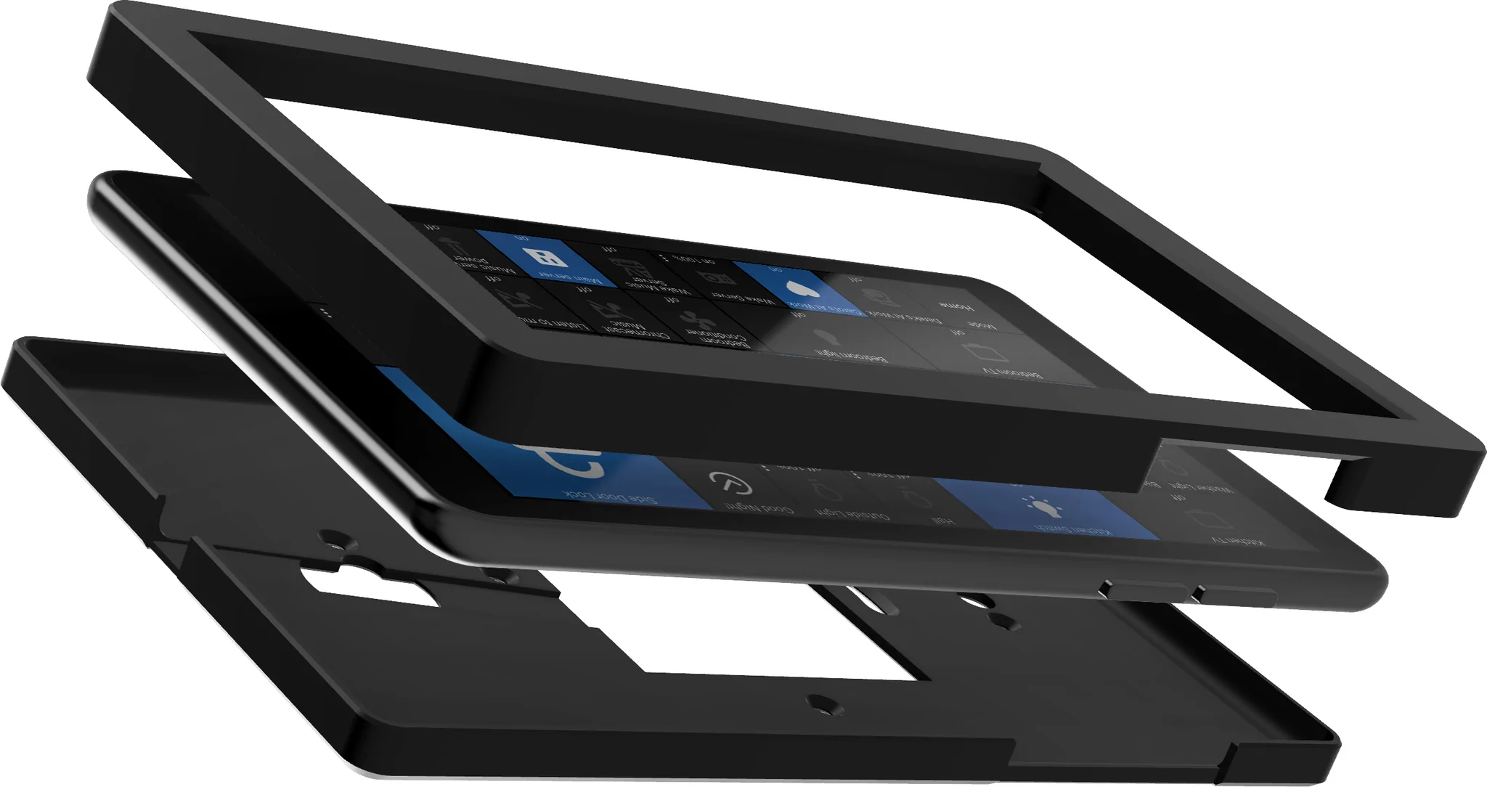
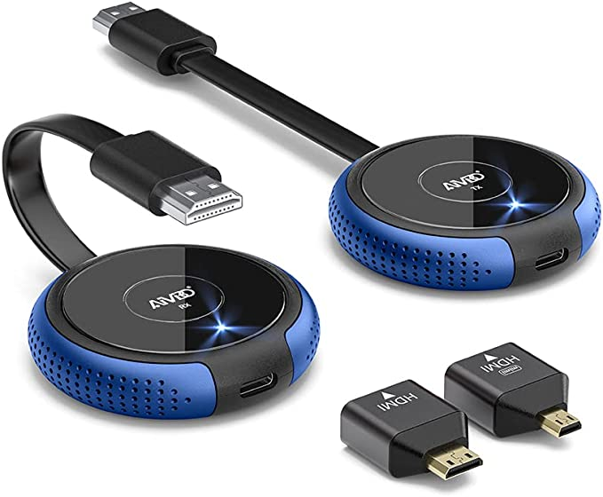
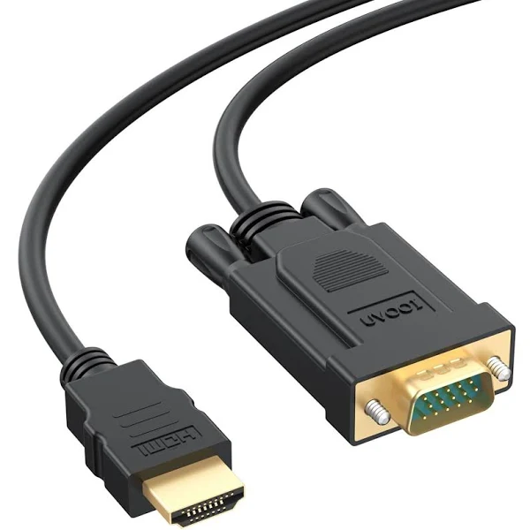


Physical Components:
Tablet
(Android Tablet Preferred)
Raspberry Pi
Stepper Motor
Programmable Controller for RPi
3D printed mount/stand
Software Components:
Wireless HDMI Receiver
Additional Cables:
HDMI
VGA

Slide 27
Test Plan:
Ensure all components of the remote controller are connected and work as intended.
Ensure tablet controlling capabilities work and the tablet fits in charging station as intended.
Ensure that the Customer is satisfied with the User experience of the application created.
Ensure that the Customer can connect all kinds of inputs.
Conduct test multiple times including a final test on site.

Slide 28
Future Steps:
Acquire tablet from Middle School
Order additional items such as programmable remote and wireless receiver
Start design and development of tablet application
Test tablet Capabilities through User-Experience Focused testing
Conduct additional test in Middle school when all components are installed.
Use remaining time to improve capabilities of tablet.

Slide 29
5. Mounting and Wiring
Lowest Deliverable: | The Projectors are mounted and powered
Desired Deliverable: | The Projectors are neatly mounted and powered with good cable management
Highest Deliverable: | The Projectors are neatly mounted and powered with good cable management and it fit the color scheme of the auditorium
Notes:
Show things like : schematic, wiring diagrams, object entity diagrams, complete algorithms, etc.)
Test Plan
List Final desired Deliverable
List one innovative aspect about your choice / one advantage this choice that the team has picked provides
List future steps for next semester regarding this subsystem

Slide 30
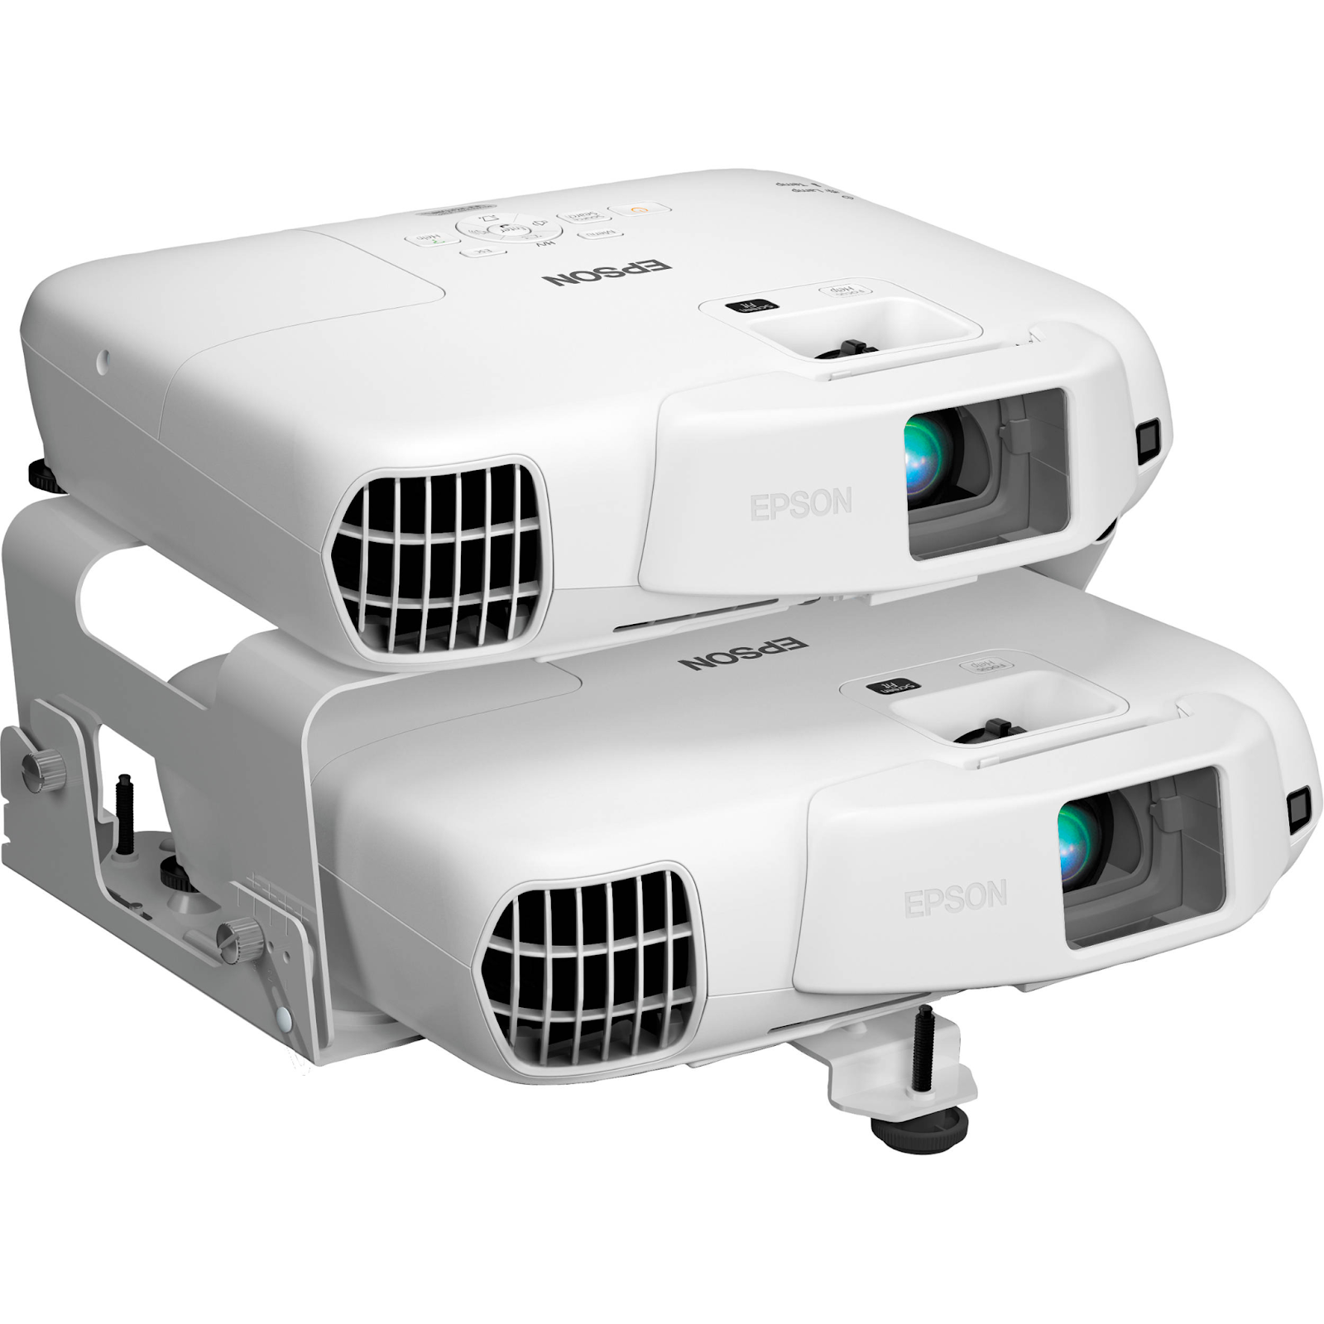
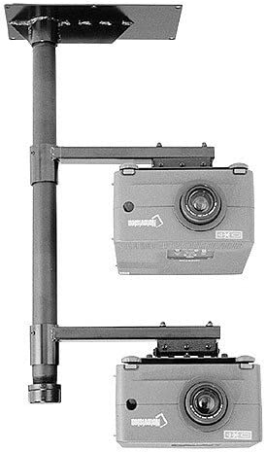
Mounting Materials
Metallic L Bracket
Pressurized Treated Wood
Size 12 Nails
20 foot Power and VGA Cables
2 foot splitter cables

Slide 31
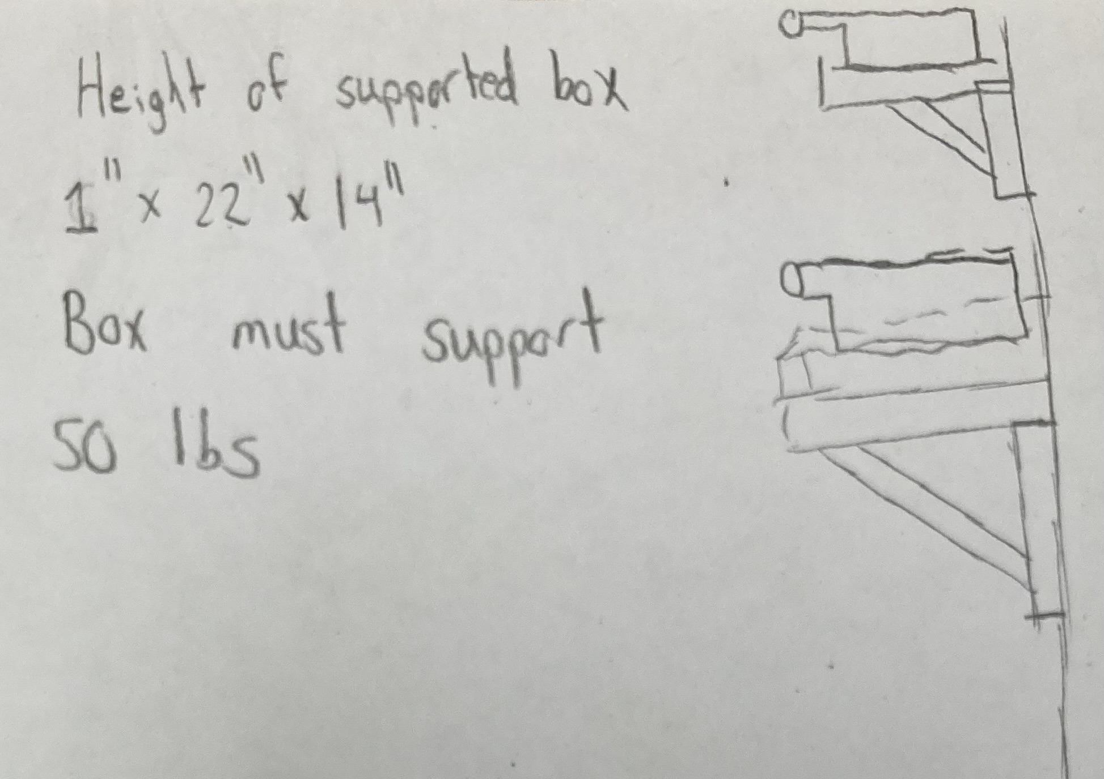

Slide 32
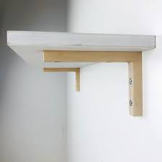
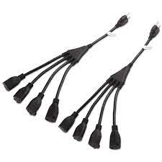
Future Steps:
We need to secure the power cables and VGA cables long enough to reach the mounted projectors
We need to need to secure splitter cables so that we can setup both projectors
The L bracket that can secure the weight needs to be purchased and it also has to be tall enough to hold both projectors
Proper installation techniques need to be wrote so that safe installation can occur

Slide 33
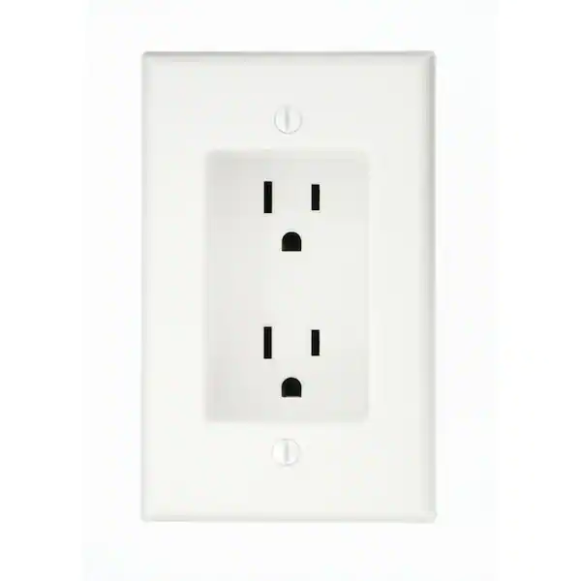
Test Plan:
We need to make sure the power outlet is working properly
The stiffness of the L bracket needs to be tested and proper installation techniques needs to be followed
With all splitter cables and large power sources we need to make sure the wall outlet can handle all power being used

Slide 34
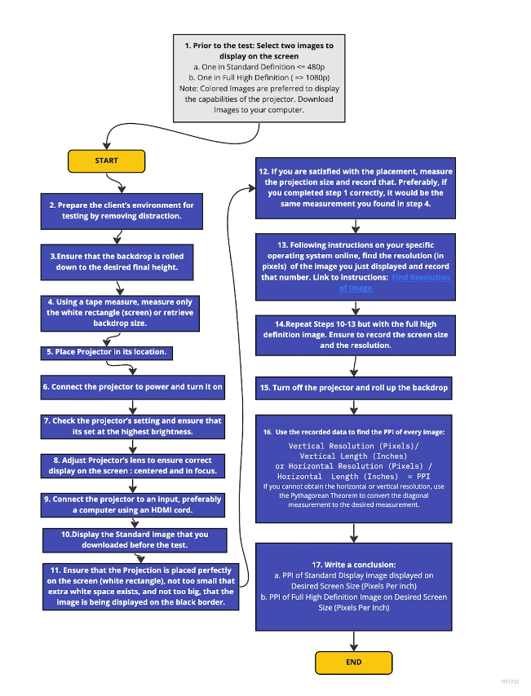
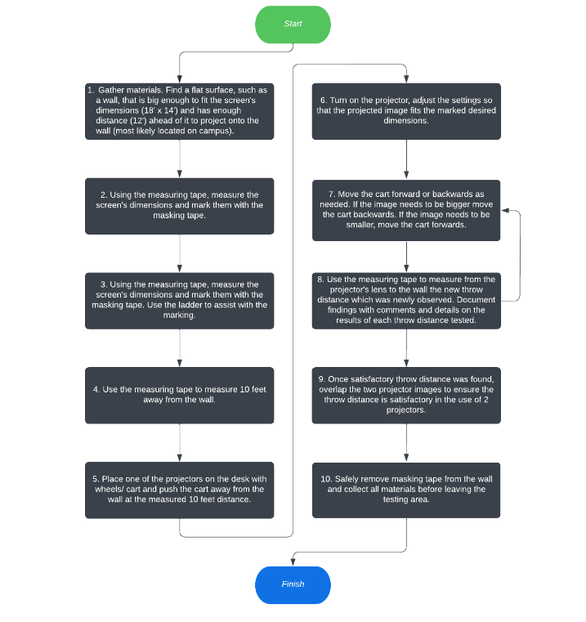
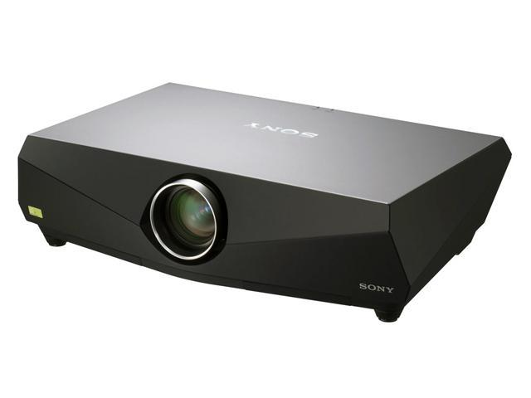
Additional Tests:
Total Projector Lumens Test
Throw Distance Test
Projector Quality Test

Slide 35
Schedule
January:
Place orders early January for any missing Components.
Start software design for tablet and any 3D-Printed Components.
February:
Have all 3D-printed components printed.
Have all ordered components ready for installation.
All subsystem should be 75%-80% function by late February.
Conduct on campus test on the subsystem of the project individually and then conduct group tests with all components.
March:
Mount system components in Middle School.
Conduct Test in Middle School.
Take final feedback from customer.
Use remaining time to introduce more innovation to the project.
Prepare for showcase at MDE.

Slide 36
Budget
Calculations for the current budget:
Projectors: $0.0 (donated)
Lens: ~$150.0/each (~$300.0)
Backdrop Screen: $2289.0
Stepper Motor + Driver: $100.0
Mounting and Wiring: $300.0
Interface Components: $185.0
Estimated Budget as of Today: $3,174.0

Slide 37
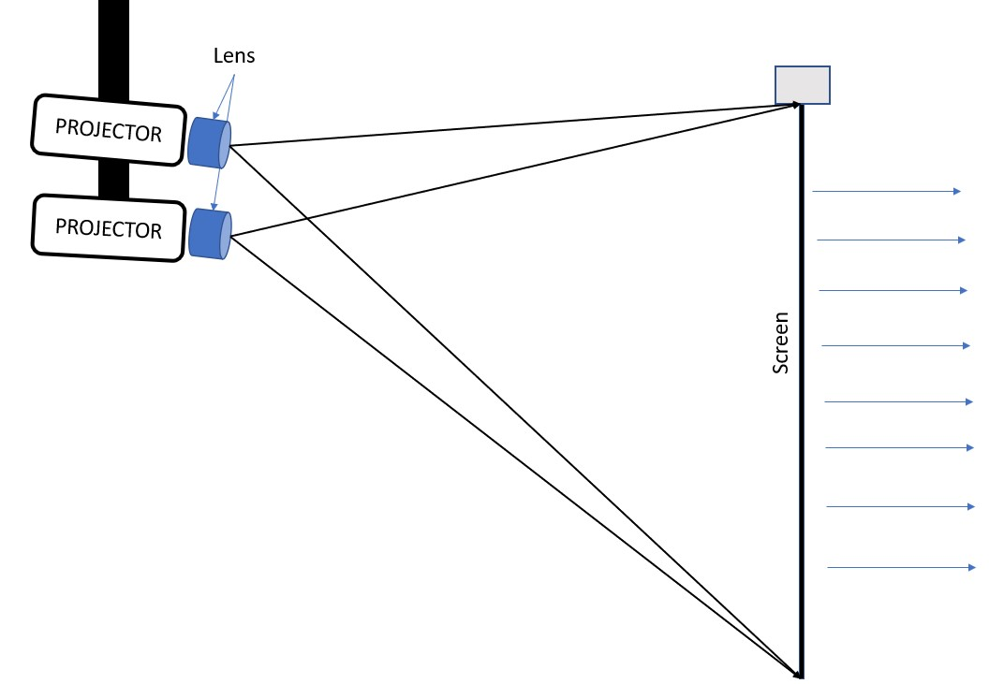
End Product
Double Projector
Rear Short Throw
Automated backdrop
Port/Power connections
Projection/Backdrop Size

